Slide 1


Intro to Angular
HTTP Basics. Angular Overview. TypeScript Syntax.
SoftUni Team
Technical Trainers
Software University
https://softuni.bg

Slide 2
Table of Contents
HTTP Basics
Routing Overview
Angular Overview
Intro to TypeScript
Angular Installation & CLI
Demo
2

Slide 3
Have a Question?
sli.do
#js-web

Slide 4

HTTP Basics
HTTP Server - Client

Slide 5
HTTP
Hyper Text Transfer Protocol (HTTP)
Client-server protocol for transferring Web resources
Important properties of HTTP
Request-response model
Text-based format
Relies on a unique resource URLs
Provides resource metadata (e.g. encoding)
Stateless (cookies can overcome this)

Slide 6
HTTP: Request-Response Protocol
Client program
Running on end host
E.g. Web browser
Requests a resource
Server program
Running at the server
E.g. Web server
Provides resources
6

Slide 7
HTTP: Request-Response Protocol (2)
GET /index.html
HTTP/1.0
HTTP/1.0 200 OK
"Welcome to our
Web site!"

Slide 8
Example: Hyper Text Transfer Protocol
HTTP request
HTTP response
GET /courses/about.aspx HTTP/1.1
Host: www.softuni.com
User-Agent: Mozilla/5.0
<CRLF>
HTTP/1.1 200 OK
Date: Mon, 5 Jul 2010 13:09:03 GMT
Server: Microsoft-HTTPAPI/2.0
Last-Modified: Mon, 12 Jul 2010 15:33:23 GMT
Content-Length: 54
<CRLF>
<html><title>Hello</title>Welcome to our site</html>

Slide 9
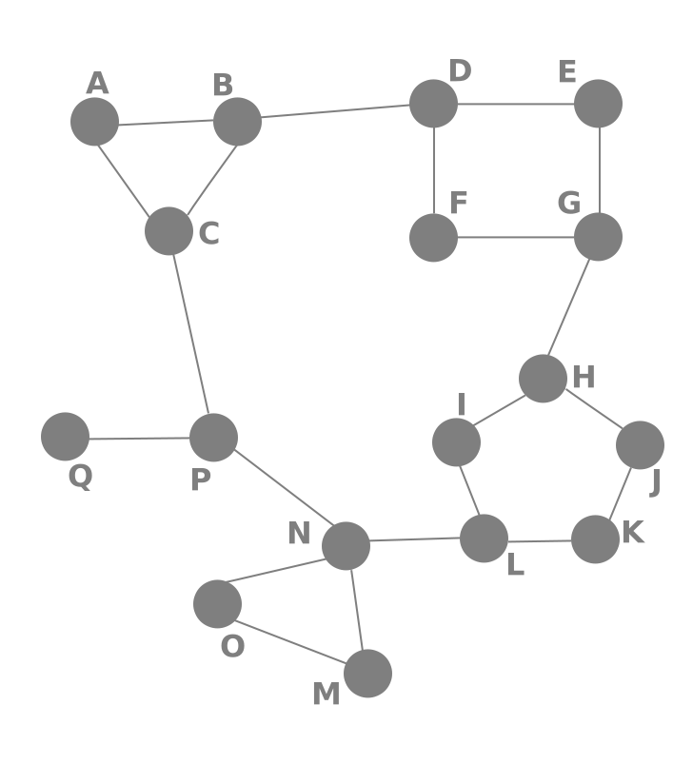
Routing Overview
Navigation for Single Page Apps

Slide 10


What is Routing?
Allows navigation, without reloading the page
Pivotal element of writing Single Page Applications
HTML
HTML
HTML
Link
HTML
HTML
ROUTER
Link
HTML
HTML
HTML
HTML
Link
Standard Navigation
Navigation using Routing
10

Slide 11

Single Page Applications
A Router loads the appropriate content when the location changes
E.g. when the user manually enters an address
Conversely, a change in content is reflected in the address bar
E.g. when the user clicks on a link
Benefits
Load all scripts only once
Maintain state across multiple pages
Browser history can be used
Build User Interfaces that react quickly

Slide 12

Angular Overview
Web Application Platform

Slide 13
What is Angular?
Angular is a platform for building complex front-end apps
Focused on end-to-end tooling and best practices
Developed by the Angular team at Google
import { Component } from '@angular/core';
@Component({
selector: 'my-app',
template: `<h1>Hello {{name}}</h1>`
})
export class AppComponent { name = 'Angular'; }

Slide 14
Angular Versions
Angular 10
Angular
Angular 8
Complete Re-Write
…
"AngularJS"
Angular 2
Just "Angular"

Slide 15

Introduction to TypeScript
A JavaScript Superset

Slide 16
Introduction to TypeScript
Install globally via npm
TypeScript uses the .ts file extension (supported by VS Code)
To compile your code
Compilation output is plain JavaScript
npm install -g typescript
tsc myfile.ts

Slide 17
Variable Types
let isDone: boolean = false;
let decimal: number = 6;
let hex: number = 0xf00d;
let binary: number = 0b1010;
let octal: number = 0o744;
let color: string = "blue";
color = 'red';
let list: number[] = [1, 2, 3];
let list: Array<number> = [1, 2, 3];
More at https://www.typescriptlang.org/docs/handbook/intro.html
17

Slide 18
Classes
Access modifier could be public/private/protected
class Greeter {
public greeting : string;
constructor(message : string) {
this.greeting = message;
}
greet() : string {
return `Hello, ${this.greeting}`;
}
}
let greeter : Greeter = new Greeter("world!");
console.log(greeter.greet());
Functions could also have a return type
18

Slide 19
Inheritance
class Animal {
move(distanceInMeters: number = 0) : void {
console.log(`Animal moved ${distanceInMeters}m.`);
}
}
class Dog extends Animal {
bark() : void {
console.log('Woof! Woof!');
}
}
const dog = new Dog();
dog.bark();
dog.move(10);
dog.bark();
19

Slide 20
Interfaces
function printLabel(labelledObj: { label: string }) {
console.log(labelledObj.label);
}
let myObj = {size: 10, label: "Size 10 Object"};
printLabel(myObj);
Property assertion
interface LabelledValue {
label: string;
}
function printLabel(labelledObj: LabelledValue) { … }
20

Slide 21
Generics and Enumerations
function identity<T>(arg: T): T {
return arg;
}
let output = identity<string>("myString");
// type of output will be 'string'
let output = identity(5);
// type of output will be 'number'
Type inference
enum Direction {
Up = 1,
Down,
Left,
Right,
}
21

Slide 22
Modules
export default interface StringValidator {
isAcceptable(s: string): boolean;
}
export { ZipCodeValidator };
export { ZipCodeValidator as mainValidator };
import { ZipCodeValidator } from "./ZipCodeValidator";
import * as validator from "./ZipCodeValidator";
import num from "./OneTwoThree";
22

Slide 23

Angular Installation
Packages, Setup, Structure

Slide 24
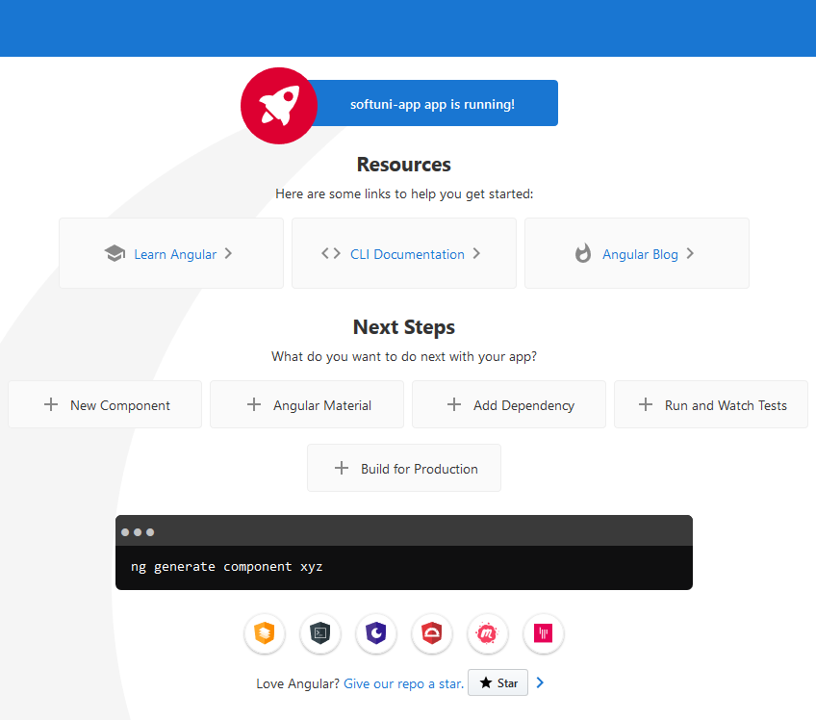
Creating A New App
Install globally via npm
Create new project
Start a dev server on port 4200
npm install -g @angular/cli
ng new some-app
cd some-app
ng serve

Slide 25
Finding Information
Visit the official website
Documentation
Online sandbox
https://angular.io/
https://angular.io/docs
https://plnkr.co/
25

Slide 26

IDE Support
Visual Studio Code fully supports TypeScript
You may use your favorite IDE (most have plugins)
By using the Angular CLI
You do not need to use a linter
You do not need install any specific plugin
Everything is included

Slide 27
Live Demo
A Simple Angular App!

Slide 28

Summary
Angular is a framework for front-end apps
TypeScript is JavaScript superset language
The Angular CLI is a complete toolkit for working with Angular
…
…
…
interface LabelledValue {
label: string;
}
function print(labelledObj: LabelledValue) { … }

Slide 29
Questions?
Notes:
29

Slide 30













SoftUni Diamond Partners

Slide 31


Educational Partners

Slide 32
Trainings @ Software University (SoftUni)
Software University – High-Quality Education, Profession and Job for Software Developers
softuni.bg, softuni.org
Software University Foundation
softuni.foundation
Software University @ Facebook
facebook.com/SoftwareUniversity
Software University Forums
forum.softuni.bg
32
Notes:
32

Slide 33

License
This course (slides, examples, demos, exercises, homework, documents, videos and other assets) is copyrighted content
Unauthorized copy, reproduction or use is illegal
© SoftUni – https://softuni.org
© Software University – https://softuni.bg
Notes:
33

